Slide 1
Task Planner
Section End Project

Slide 2
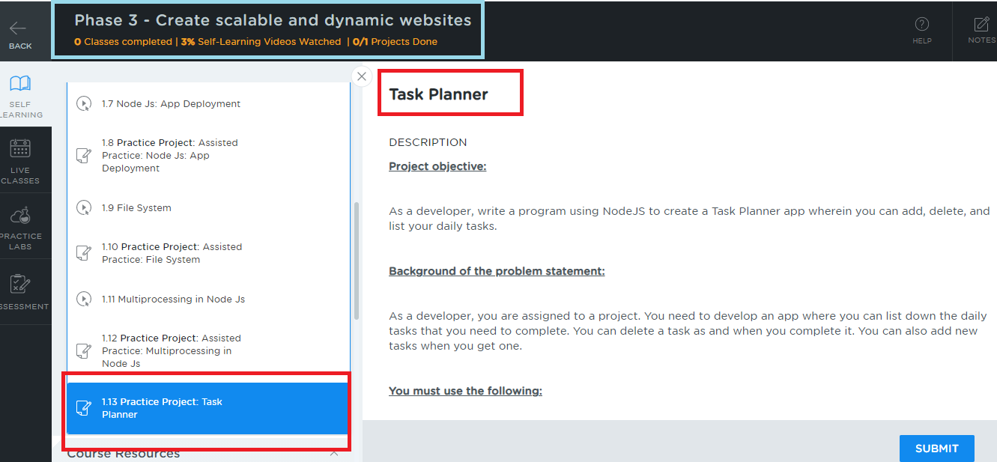
Project Location
Choose Phase3, select the section 1, lesson 1, scroll down to end you will get 1.13 Practice project

Slide 3
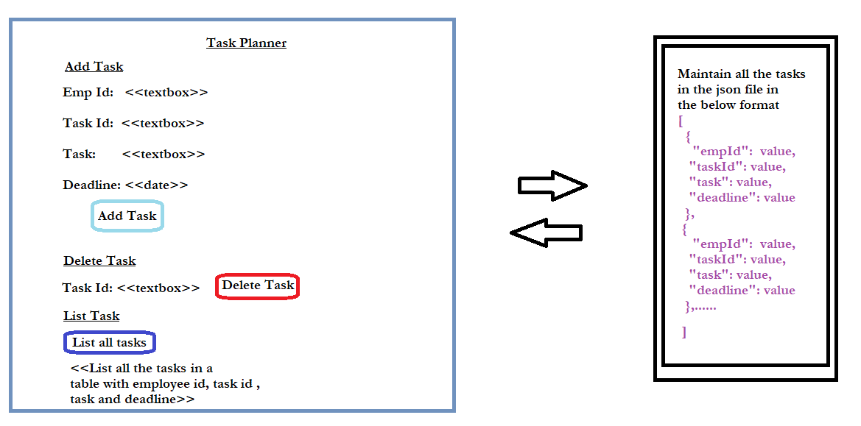
Project Implementation

Slide 4
Project Implementation
To add the task you can enter employee id, task id, task and dead line manually
Ensure that the task id you are entering is unique.
Same employee id can have multiple task
The task should be added in a JSON file
Delete the task based on the task id
List all the tasks in the HTML table

Slide 5
Project Implementation
You can ignore styling the html.
The diagram which shows the html is a generic template, you can implement the operations like adding, deleting and retrieving in different page if you want.

Slide 6
Important things to consider while submitting
Write Up
Don’t push the document into the Git repository, use .gitignore file
Better create separate folder for the project inside the git repository
Mention the Git repo link in the document
Mention the folder name that has project in the document
Give brief information about the source code files to make us understand what is the purpose of the file in the document.
EX: index.html is the main page which has links to Home, Services, Contacts
EX: styles.css is the style sheet that is used to design web page
EX: myscripts.ts is the typescript code which has functions like search() to search the data

Slide 7
Important things to consider while submitting
Screenshot
Add the screen shot of the project output
You are allowed to add multiple screen shots in case required
Source Code
Wrap all the source codes like html, css, js, ts, etc in a zip
Upload the zip
If in case zip is not supported you can attach all source codes one by one
Note:
While pushing the project in Git repository you can have all your assignments and projects in a single repository
Create separate folders for each project in the Git repository, however you can mention these folder names in the document

Slide 8
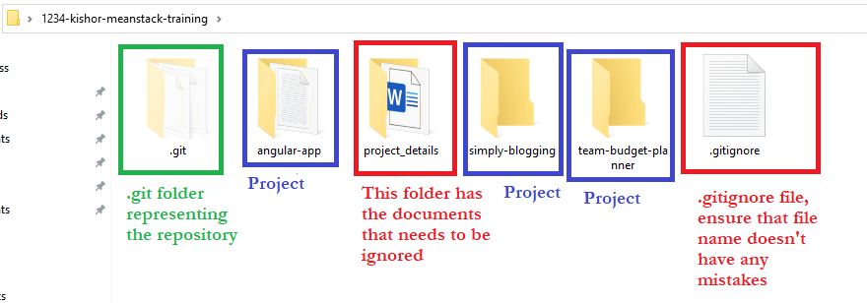
How to ignore document not to track in git
Create a folder in the repository with some name, e.g., project_details, keep all the documents inside this folder
Open .gitignore file and add the folder name entry as project_details/
Below is a screenshot of the local repository to understand where to keep .gitignore file, notice its inside the repository 1234-kishor-meanstack-training

Slide 9
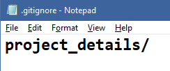
Adding the project_details folder entry inside .gitingore file
Open .gitignore file and add the folder project_details that has all the documents explaining each project
When you enter git status you can notice that project_details folder wouldn’t be tracked

Slide 10
1. Don't use express module, use only http module, fs module, url module and etc
2. Don't create html files, create html content int he javascript code that is run by
node.js
3. No angular project
4. Manually enter the unique task id
5. While deleting load the json data to the array and delete and write to the json file
6. Don't use json-server, use node.js 'fs' module to modify the json file
7. Old tasks must also be present in the JSON unless its not deleted

